Slide 1
1
Typed languages
6
Polymorphism
OOP
2
Object/Class
5
Inheritance
3
Aggregation
4
Encapsulation

Slide 2




UML multiplicities
1
*
Can you assign the multiplicity
Of those elements related to a man ?
Exactly 1 instance
0 to many
0..1
+
0 or 1 instance
1 to many
5
Exactly 5 instances

Slide 3

NAVIGATION

Slide 4

#activity 1
Complete this code to get the color of the bedroom main window
House
Room
Window
START HERE
1
bedroom
1
mainWindow
GO HERE
color : string
let sophanaHouse: House; // Note : We don’t detail the initialization
Let theColor= sophanaHouse. ??

Slide 5
Complete this code to get the color of the bedroom main window
House
Room
Window
START HERE
1
bedroom
1
mainWindow
GO HERE
3
color : string
1
2
4
let sophanaHouse: House; // Note : We don’t detail the initialization
Let theColor= sophanaHouse.bedroom.mainWindow.color

Slide 6
#activity 2
Complete this code to get the color of the first window of the living room
House
Room
Window
1
bedroom
*
windows
color : string
1
livingRoom
let sophanaHouse: House; // Note : We don’t detail the initialization
Let theColor= sophanaHouse. ??

Slide 7
Complete this code to get the color of the first window of the living room
House
Room
Window
1
bedroom
*
windows
3
color : string
1
1
livingRoom
2
4
let sophanaHouse: House; // Note : We don’t detail the initialization
Let theColor= sophanaHouse.livingRoom.windows[0].color;

Slide 8
Can you access to the house address from the bedRoomWindow object ?
House
Room
Window
START HERE
1
bedroom
1
mainWindow
address : string
color : string
GO HERE
let bedRoomWindow: Window; // Note : We don’t detail the initialization
Let houseAddress= bedRoomWindow. ??

Slide 9

Can you access to the house address from the bedRoomWindow object ?
NO !
The windows does not have a reference to the parent room
The room does not have a reference to the house
House
Room
Window
1
bedroom
1
mainWindow
START HERE
address : string
color : string

Slide 10
Mono directional association
Browse model from parent to children
Grand Parent
Parent
Child
*
1

Slide 11
Bi directional association
Browse model from children to parent
Grand Parent
Parent
Child
1
*
1
1

Slide 12


The parent knows the child
+
The child knows the parent
class Parent {
child?: Child;
}
class Child {
parent?: Parent;
}
// Create the objects let the_parent = new Parent();
let the_child = new Child();
// make the links
the_parent.child = the_child;
the_child.parent = the_parent;
Parent
Child
1
1

Slide 13

ENCAPSULATION

Slide 14

Is this code safe ? Why ?
class BankAccount {
name: string;
balance: number = 0;
constructor(name: string) {
this.name = name;
}
}
let ronanAccount = new BankAccount("ronan");
ronanAccount.balance -= 1000; // Debit 1000 dollars !!!!

Slide 15

class BankAccount {
private name: string;
private balance: number = 0;
constructor(name: string) {
this.name = name;
}
debit(amount:number) {
if (this.balance – amount >=0 ) {
this.balance -= amount;
}
}
}
let ronanAccount = new BankAccount("ronan");
ronanAccount.debit(1000);
Let’s put our data private
Let’s add a method to
debit
money
Now the
Operation
Will not be
Possible !!

Slide 16
In OOP we want to protect our data !!!
OBJECT
METHODS
METHODS
PRIVATE DATA
PRIVATE DATA

Slide 17
A getter is to get data
A setter is to set data
class BankAccount {
private name: string;
getName() : string {
return this.name;
}
class BankAccount {
private name: string;
setName(newName:string) {
this.name = newName;
}

Slide 18

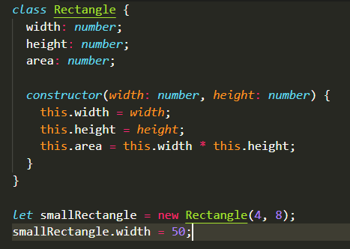
ACTIVITY 3
// 1-Look at the code : what is the problem after you changed the width to 50 ?
// 2 –Fix this code by encapsulating the data and adding methods

Slide 19


Let’s update our UML class diagram !
-
+
PRIVATE
PUBLIC
DoorWithLock
-
doorId: string
secretKey : string
-
Only the
Method is
Public here
+
canOpen(key:string) : boolean

Slide 20

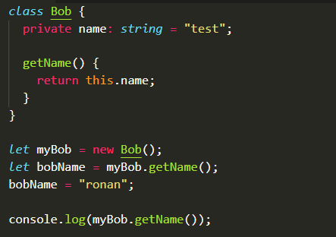
What this will code display ?
A - ronan
B - test
C – error

Slide 21
DOES THIS CODE WILL RAISE AN ERROR ?
House
Room
Window
- bedroom
+ bigWindow
1
1
+ color : string
let sophanaHouse = new House();
Let theColor= sophanaHouse.bedroom.bigWindow.color
A
No
B
YES

Slide 22
DOES THIS CODE WILL RAISE AN ERROR ?
House
Room
Window
- bedroom
+ bigWindow
1
1
+ color : string
let sophanaHouse = new House();
Let theColor= sophanaHouse.bedroom.bigWindow.color
A
YES
B
YES

Slide 23
DOES THIS CODE WILL RAISE AN ERROR ?
House
Room
Window
- bedroom
+ bigWindow
1
1
- color : string
+ getBedroom()
let sophanaHouse = new House();
Let theColor= sophanaHouse.getBedroom().bigWindow.color
A
YES
B
YES

Slide 24
DOES THIS CODE WILL RAISE AN ERROR ?
House
Room
Window
- bedroom
+ bigWindow
1
1
- color : string
+ getBedroom()
let sophanaHouse = new House();
Let theColor= sophanaHouse.getBedroom().bigWindow.color
A
YES
B
YES

Slide 25
DOES THIS CODE WILL RAISE AN ERROR ?
House
Room
Window
- bedroom
+ bigWindow
1
1
+ color : string
+ getBedroom()
let sophanaHouse = new House();
Let theColor= sophanaHouse.getBedroom().bigWindow.color
A
YES
B
YES

Slide 26

TO SUM UP
UML multiplicities : 1, 0..1, 5 , many etc.
We sometimes need to navigate in 2 directions in our model
This requires to keep the reference of the “parent” in the “child”
We need to protect our data, and provide methods to set or get the data

Slide 27

WANT TO GO FURTHER ?
CLASSES & OBJECTS IN TYPESCRIPT
https://www.typescriptlang.org/docs/handbook/classes.html

